Slide 1


Chatbot Intent Architecture
Samuel Sears
Bellevue University

Slide 2
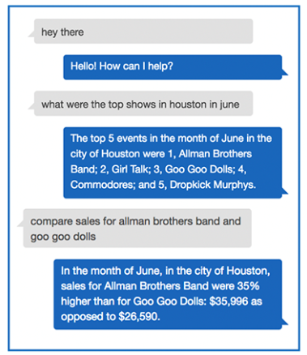
Chatbot Basics
Chatbots are trained to classify a user’s natural language as an intent
Intent – A classification the bot is trained on using a group of similar utterances
Utterance – What the user says to the bot
Once an intent is recognized, a programmed conversation may begin. (ex. AWS Lambda)
Notes:
Image: https://aws.amazon.com/blogs/machine-learning/building-a-conversational-business-intelligence-bot-with-amazon-lex/

Slide 3
Problem
Given a dataset of user utterances, how do we determine the intents?
Manually label the utterances one-by-one
Too much time
Filter the utterances by keywords
Different words may mean the same thing – or the same words may mean different things
Deploy intents iteratively
High chance of mistaking untrained utterances as trained ones
Solution: Cluster entire dataset of user utterances and use the resulting clusters as the intents.

Slide 4
Dataset
Intents | Count of utterance
cancel_order | 36
change_order | 926
change_shipping_address | 110
check_cancellation_fee | 360
check_invoices | 1013
check_payment_methods | 270
check_refund_policy | 470
complaint | 746
contact_customer_service | 2055
contact_human_agent | 1093
create_account | 2123
delete_account | 913
delivery_options | 360
delivery_period | 141
edit_account | 133
get_invoice | 1430
get_refund | 1150
newsletter_subscription | 236
payment_issue | 4366
place_order | 70
recover_password | 986
registration_problems | 130
review | 580
set_up_shipping_address | 96
switch_account | 273
track_order | 1303
track_refund | 303
Grand Total | 21672
Bitext free dataset – customer support

Slide 5
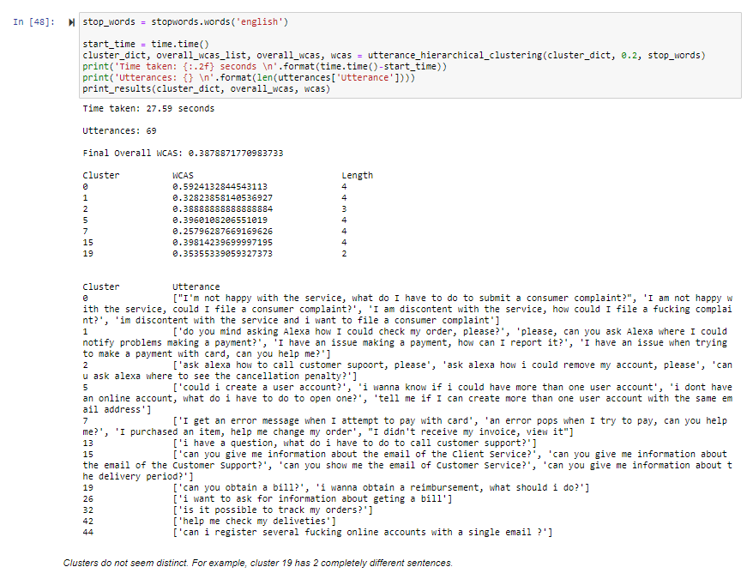
Hierarchical Clustering with Cosine Similarity
Method:
Hierarchical clustering
Utterance -> vectors
Cosine Similarity = distance measure
Issues:
Took too much time
Lexical similarity vs Semantic similarity

Slide 6
Clustering with Word2Vec Word Embedding
Train word embedding model using entire dataset
Transform sentences into vectors
Fit clustering model
Train / Test bot

Slide 7
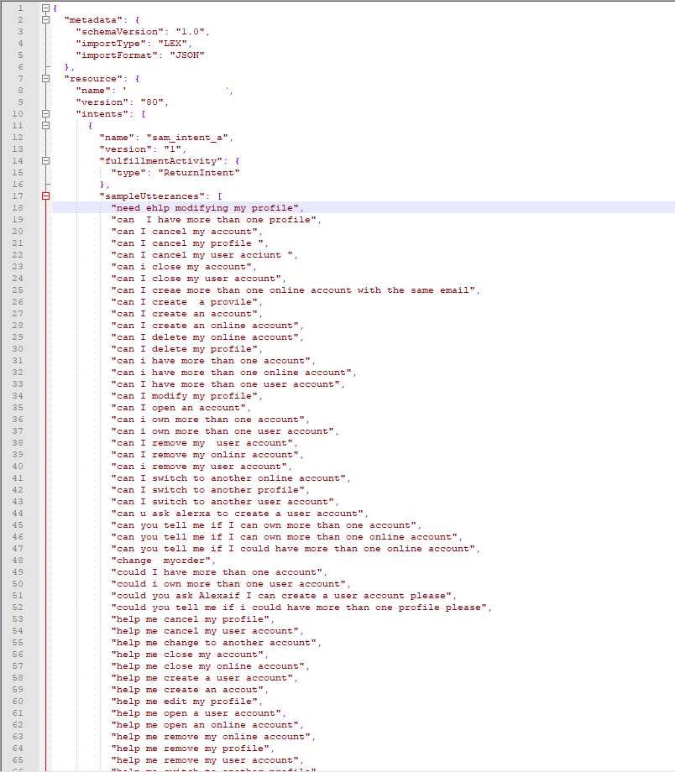
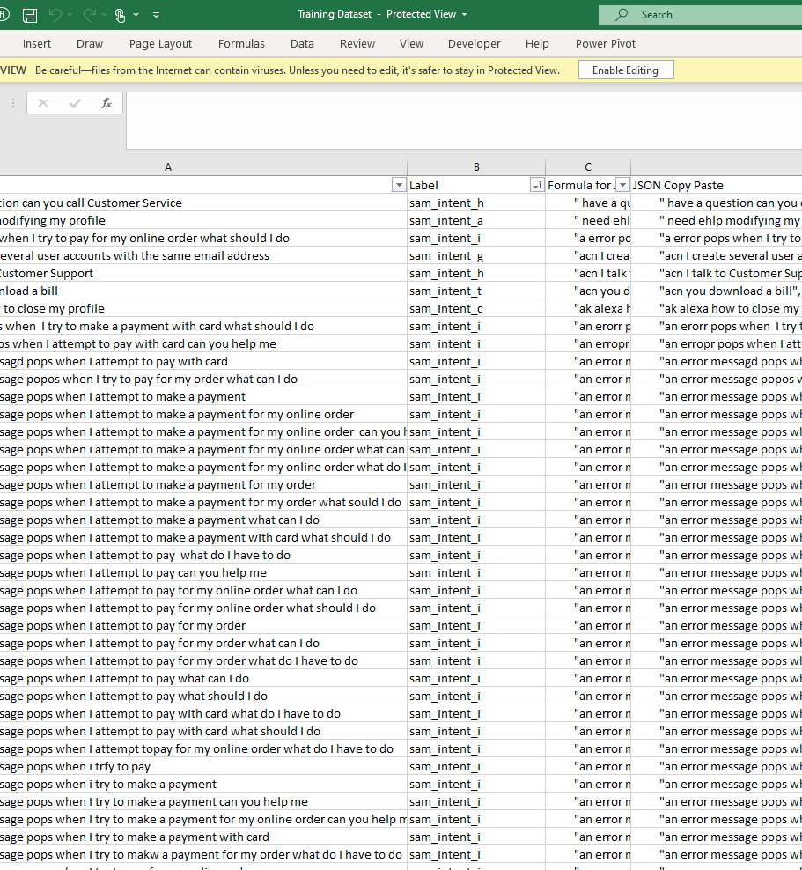

Slide 8
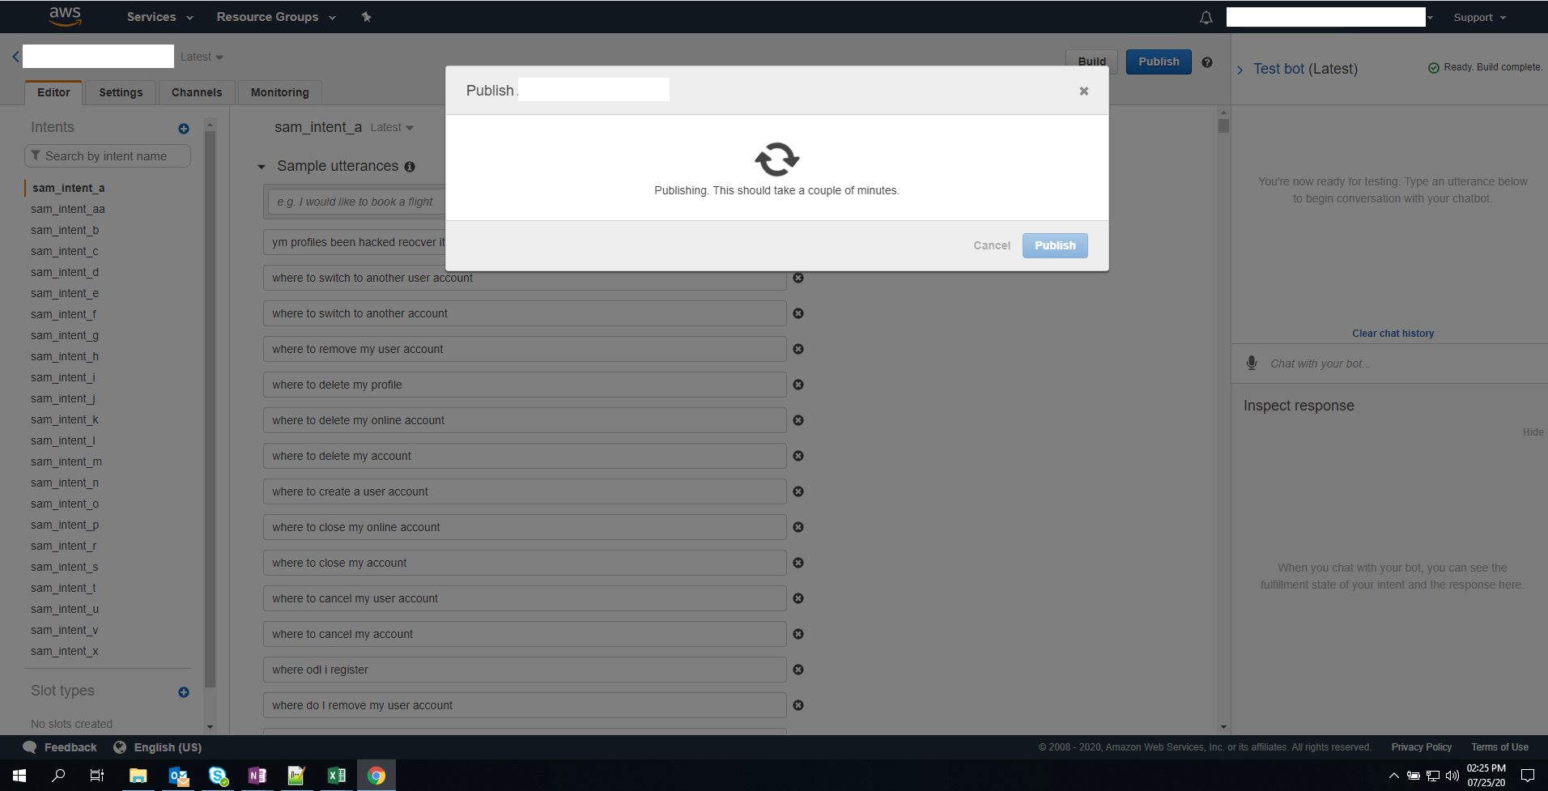

Slide 9
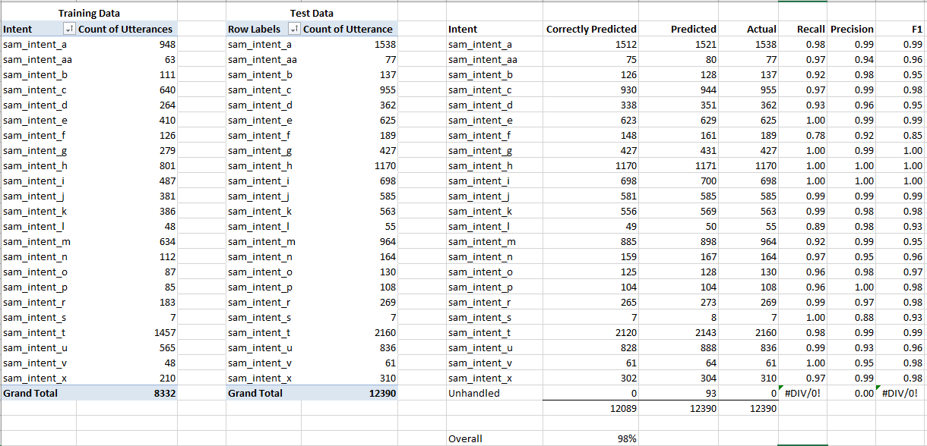
Results – 98% Accuracy

Slide 10
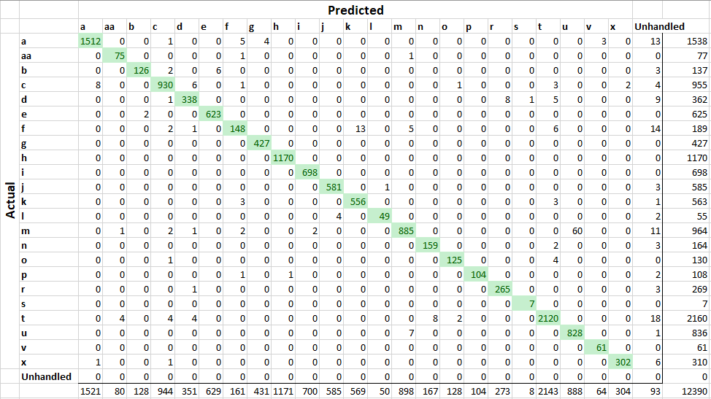
Confusion Matrix

Slide 11
Resources
Cosine Similarity Between Sentences: https://www.geeksforgeeks.org/python-measure-similarity-between-two-sentences-using-cosine-similarity/
Word Embedding: https://machinelearningmastery.com/develop-word-embeddings-python-gensim/
Word2Vec: https://towardsdatascience.com/a-beginners-guide-to-word-embedding-with-gensim-word2vec-model-5970fa56cc92
AgglomerativeClustering: https://scikit-learn.org/stable/modules/generated/sklearn.cluster.AgglomerativeClustering.html
Dataset: https://blog.bitext.com/free-customer-support-dataset

